Slide 1

Geo-Service Portal
M.Tech. Thesis Presentation
Submitted by
Deepak Punjabi - 15IT60R17
Under Guidance of
Prof. Soumya K. Ghosh

Slide 2

Spatial data
is data containing Information about
the locations and shapes
of geographic features
and the relationships between them,
usually stored as coordinates and topology.
Notes:
First we need to understand what is spatial data.
Type of spatial data

Slide 3
Motivation
Applications of spatial data
Problems with currently available solution
Notes:
Now lets see why do we need spatial data
And how it can be useful to us

Slide 4
Use Cases
Remote Sensing
Area affected by flood/disease
Spatio-Temporal analysis
Spatial data mining
Telecom & Network Services
Urban Planning and Hot spot analysis
Navigation
And many more…
Notes:
There are many industrial and research based applications for spatial data.
Some of them are mentioned here.

Slide 5
Current Challenges
General search engines are not good for searching spatial data.
Spatial data contains complex data types & operations.
Not all spatial data is publicly available.
Notes:
Why don’t we just search on Google or Bing that how much area is forest, or
How much elevation of water has changed in medinipur area?
General search engines are not very accurate and efficient when it comes to spatial data.
The reason behind this is.. Spatial data has complex data structure and operations
Second important reason is not all spatial data is publicaly avail.
Many of the gov egencies hold licenses for spatial data. NASA and ISRO being one of them
Some large companies has openly available data like Google or mIcorsofy,
But they are not free for business use
Data is unstructured and heterogeneous
Why it is not searchable via normal search engines.
Licensed
Gov egencies like NASA , ISRO & some organizations have ownership of the data, not available for everyone.
Not indexed/ranked for these reasons

Slide 6
Proposed Solution
Data Provider 1
Geo-Service
Portal
Foundation Framework
Rep 1
Interfaces
for
External
Applications
&
Services
Catalog
Service 1
Rep 2
Notes:
Fortunately there is a way, Gov egencies are ready to share the data with india based institutes and organizations
We want to build a foundation framework Geo-service portal.
That is a OGC compliant standardized catalog service based on service oriented architecture.
So that it can be used by various external applications and services.

Slide 7
Problem Statement
Defining the problem
Defining the solution objectives

Slide 8
Aim
Build a catalog service for web
to crawl, store, maintain, and publish
metadata information about spatial data
and it’s providers and to utilize this information
to perform efficient query orchestration.

Slide 9
Objectives
Build a topical crawler to crawl the web and store geo-spatial metadata.
Build an Open Geospatial Consortium (OGC) compliant catalog service to publish and search accumulated metadata.
Build Query orchestration service to perform real-time query with heterogeneous data sources and cost matrices associated with them.

Slide 10
Solution Model
Spatial Web Crawler
Catalog Service
Query Processing

Slide 11
3 stage approach
1
Spatial Web Crawler
2
Catalog Service
3
Query Processing

Slide 12
Spatial web crawler: Objectives
Build a spatial web crawler which crawlers through geo-servers which offers Web Feature Service(WFS) based OGC compliant services.
Build a domain specific vocabulary(ontology) for this features which can be helpful to compare found features with wanted features.
Perform semantic matching of found features from crawled web-pages with given ontology for filtering the correct features and storing them in the permanent repository.
Perform an evaluation of the given spatial web crawler using metrics and test URL seed sets.

Slide 13
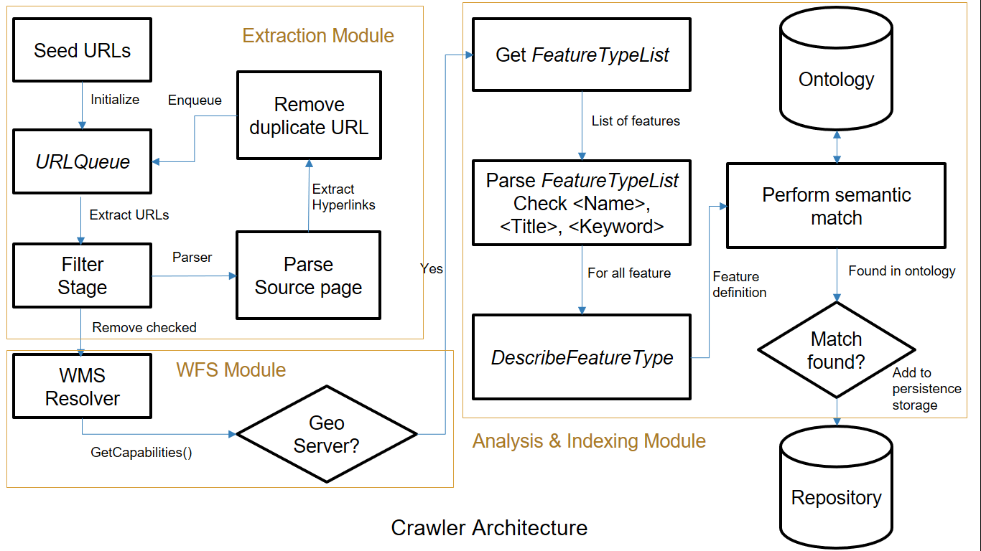
Spatial web crawler: Architecture

Slide 14
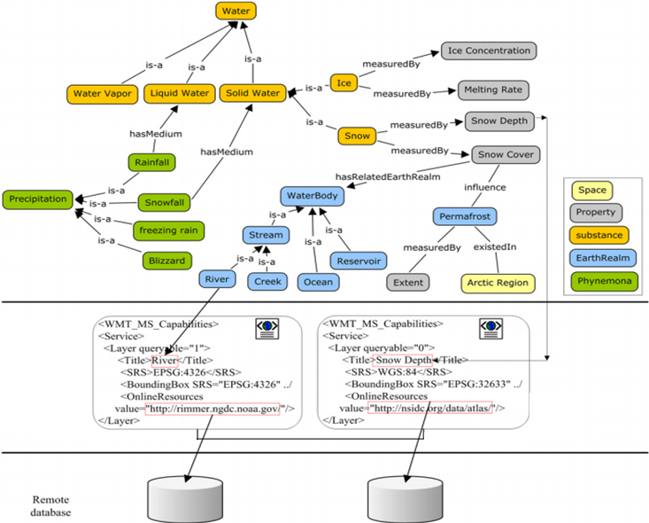
source: Li, W., et al. Computers & Geosciences,2011.

Slide 15
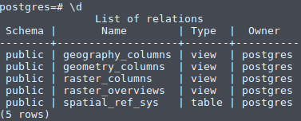
Architecture
Rep 1
Rep 2
Rep 3
GetCapabilities()
Crawler
setup_db
Catalog
Server
services.xml
Interfaces
for
external
Applications
&
Services
Database
Directory of XML files
load_records
WSGI server
PostgreSQL
Manual Addition

Slide 16
Database Setup
First extend the database for Geo-spatial operations and data structure support. < create extension postgis ; >
Setup tables and their schema. < setup_db >
Services xml files are used to populate the database. Import data from xml files using < load_records > command.

Slide 17
Query Processor
Database holds all metadata information about the data available from repositories.
Type of queries
Metadata Query
Request for the data object
Request 1: GetLayerNames()
Metadata Query
Catalog
Server
Response
Request 2: GetMap()
Data Query
GetMap()
Rep 1
Response image
Map object

Slide 18
Results
List of available Layers:
List of available Operations
kgp:POPULATION
kgp:bnk block boundary
kgp:bnk block hq
kgp:bnk district boundary
kgp:bnk drainage
kgp:bnk grampanchayat boundary
kgp:bnk mouza boundary
kgp:bnk road
GetCapabilities
GetMap
GetFeatureInfo
DescribeLayer
GetLegendGraphic
GetStyles

Slide 19
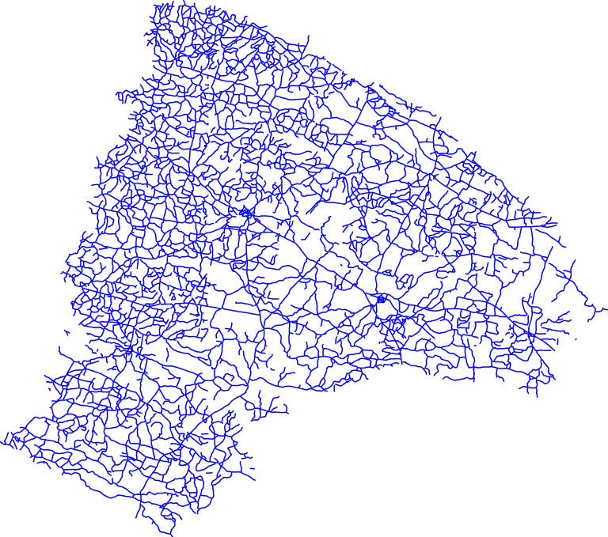
GetMap
GetMap returns a map image of the layer(s) in available formats.
Options:
Layers=kgp:bnk_road
Width=768
Height=679
Format=image/png

Slide 20

DrawMap
DrawMap Overlays different map images on top of each other.
Useful to find affected area.
Options:
Layers = { kgp:bnk_road, kgp:bnk_block_hq, kgp:bnk_block_boundary }
Width = 768
Height = 679
Format = image/png

Slide 21
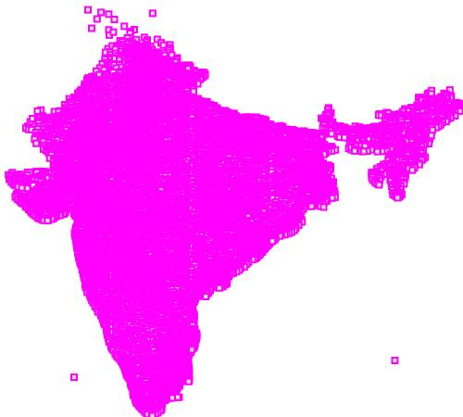
Information about specific layer *
Title | POPULATION
Name | kgp:POPULATION
Is Queryable | 1
Is Opaque | 0
Bounding Box |
minx | 68.52669525146484
miny | 8.086045265197754
maxx | 97.3387680053711
maxy | 35.8697509765625
* This image shows population density in India,
without any information on boundaries.

Slide 22
Conclusion
Geo-service portal acts as a underlying framework or foundation for various kind of higher level use cases.
Building an OGC compliant web service catalog can also be beneficiary as already available software and services can use the registry for various kinds of services with little to no modification of their original code-base.

Slide 23
Future Work
Build a cloud based implementation for the spatial web crawler, catalog service and query processing.
Build interfaces and implementation for more complex queries.
Provide parallel query processing for same data occurring in multiple repositories.
Implement model for ranked retrieval.
Notes:
//Cloud based approach provides higher availability, scalability, and better version control without needing to shutdown the system to implement changes.

Slide 24
References
Patil, Sonal, Shrutilipi Bhattacharjee, and Soumya K. Ghosh. A spatial web crawler for discovering geo-servers and semantic referencing with spatial features. International Conference on Distributed Computing and Internet Technology. Springer International Publishing, 2014.
Li, Wenwen, Chaowei Yang, and Chongjun Yang. An active crawler for discovering geospatial web services and their distribution pattern. A case study of OGC Web Map Service. International Journal of Geographical Information Science 24.8 (2010): 1127-1147.
Najork, Marc. Web crawler architecture. Encyclopedia of Database Systems. Springer US, 2009. 3462-3465.
Ahlers, Dirk, and Susanne Boll. Location-based Web search. The Geospatial Web. Springer London, 2009. 55-66.
Li, W., et al. Semantic-based web service discovery and chaining for building an Arctic spatial data infrastructure. Computers & Geosciences 37.11 (2011): 1752-1762
Notes:
//Cloud based approach provides higher availability, scalability, and better version control without needing to shutdown the system to implement changes.

Slide 25
References (continue)
Jiang, Jun, Chong-jun Yang, and Ying-chao Ren. A Spatial Information Crawler for OpenGIS WFS. Sixth International Conference on Advanced Optical Materials and Devices. International Society for Optics and Photonics, 2008.
http://geopython.github.io/pycsw-workshop/
https://geopython.github.io/OWSLib/
Notes:
//Cloud based approach provides higher availability, scalability, and better version control without needing to shutdown the system to implement changes.

Slide 26
Thank You

